Slide 1


AIS Big Data Introductory Training
UNSD | May 2023
Notes:
Hello everyone! Welcome to the AIS big data introductory training session.
So nowadays, big data are widely used in may fields, and today I would like to introduce a useful big data source that can be used in the field of analyzing, estimating and forecasting international trade. And that is AIS big data

Slide 2
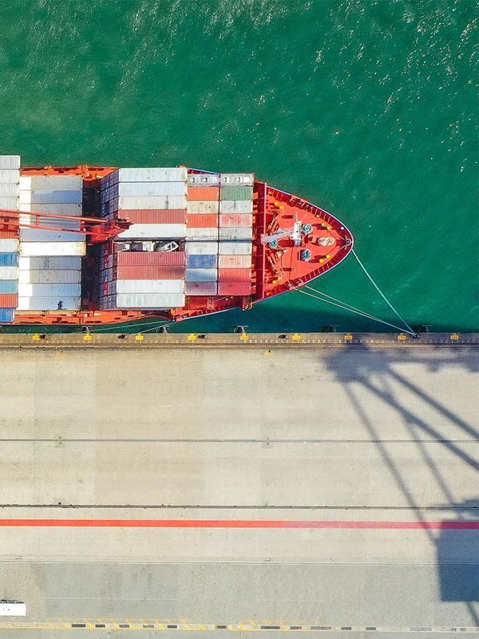
Outline
Overview
What is AIS Data
AIS Data generation
Accessibility of AIS data
AIS Data Use Cases
Acquiring AIS Data
Useful recourse and learning opportunities
Notes:
So for this session, I am going to firstly give you an overview of What is AIS data, it's strength and weakness and the accessibility of the AIS Data.
Then I would go into detail of how to acquire AIS data. And finally show you some use cases of using AIS data.

Slide 3
Overview
Notes:
Let’s start with an overview of what is AIS, and what is AIS data.
(add a map – show AIS Big Data)

Slide 4
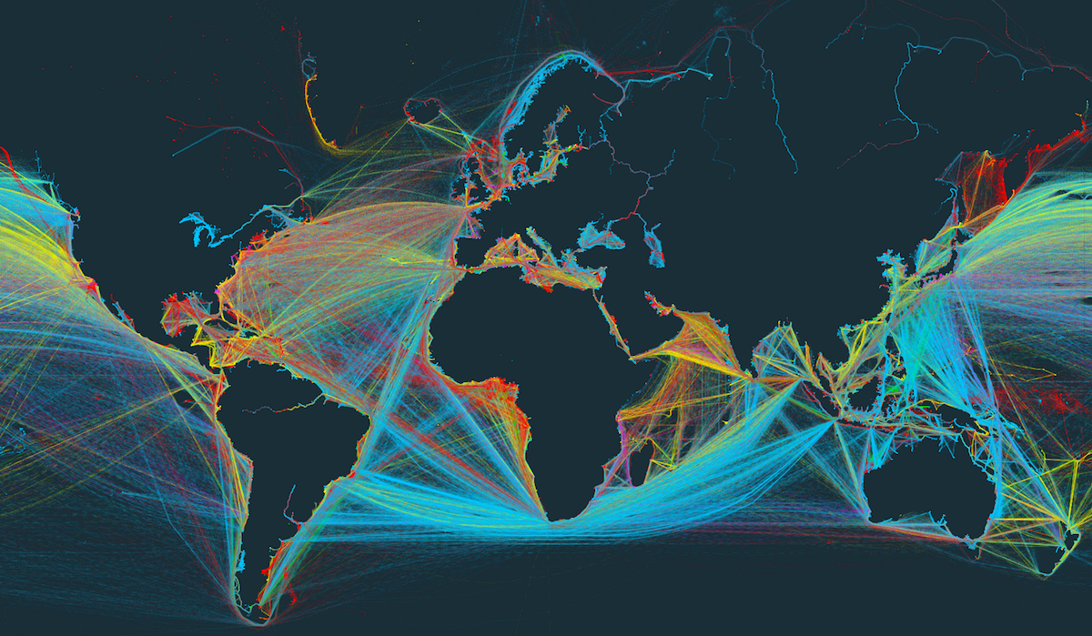
About AIS
The Automatic Identification System (AIS) is an automated, autonomous tracking system which can be used for the exchange of navigational information between AIS-equipped terminals.
It allows vessels like cargo ship, tanker, fishing vessel or passenger ship to periodically broadcast their information.
AIS was originally developed by IMO (International Maritime Organization) in 2004, solely for collision avoidance among large vessels at sea that are not within range of shore-based systems.
Now, AIS data provides a big data source of unrivaled quality above and beyond its original application for collision avoidance.
Notes:
Well, AIS refers to the Automatic Identification System used by ships globally.
It is an automated, autonomous tracking system which can be used for the exchange of navigational information between AIS-equipped terminals.
It allows vessels like cargo ship, tanker, fishing vessel or passenger ship, to periodically broadcast their information.
AIS was originally developed by IMO (International Maritime Organization) in 2004, solely for collision avoidance among large vessels at sea that are not within range of shore-based systems.
Now, AIS data provides a big data source of unrivaled quality above and beyond its original application for collision avoidance.

Slide 5
About AIS Big Data
The system stores more than 11 million AIS messages a day
There are 27 different AIS messages containing different types of information
AIS data mainly comprised of 3 information categories, which are Static data, dynamic data, and voyage-related data.
Static data | Dynamic data | Voyage-related data
information on ship characteristics | information on ship position and movements | information on a current voyage
MMSI, IMO number, call sign, ship name, type, dimensions | Ship’s position (long, lat), speed over ground (SOG), course over ground (COG), navigation status | Destination, estimated time of arrival, drought (Time does not exist in AIS frames. It is added by receivers)
Notes:
In terms of AIS big data, the system stores more than 11 million AIS messages a day. Now the data volume is about tens of terabytes.
There are 27 different AIS messages containing different types of information.
AIS data mainly comprised of 3 information categories, which are Static data, dynamic data, and voyage-related data.
For Static data, it refers to information on ship characteristics, like MMSI the Maritime Mobile Service Identity, IMO number, call sign, ship name, type, and dimensions.
Dynamic data is information on ship position and movements, like: long, lat of ship’s position, speed over ground (SOG), course over ground (COG), and navigation status
Voyage-related data refers to information on a current voyage, like Destination, estimated time of arrival, and drought

Slide 6
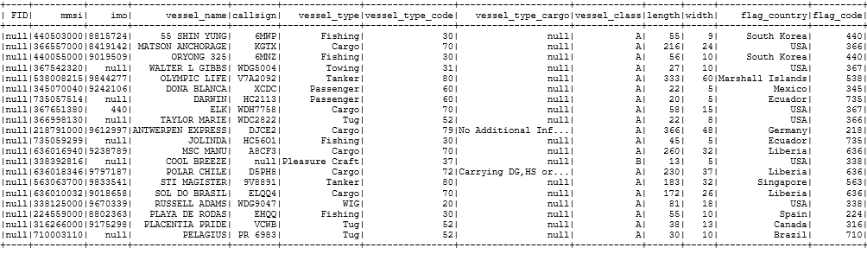
AIS Data example
Vessel ID
Vessel name
Vessels Type
Vessels Size
Vessels Flag
Notes:
Now let me show you some AIS data examples, to give you a clearer picture to let you know what does the AIS data look like
So here are some example records. As you can see here, it has some columns about the vessel ID, like the FID, mmsi, imo number,
And it also includes information of vessel name, vessel type, vessel class,
And the length and width of the vessel, and the nationality of the vessel.

Slide 7
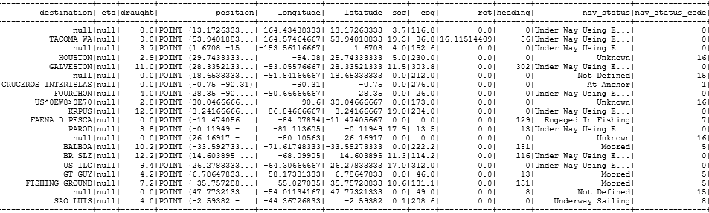
AIS Data example
Destination
Geospatial location
Speed
Navigation Status
Notes:
Apart from this, it also includes information such as the destination,
geospatial location, as you can see in this table, we can get position point, longitude, and latitude here.
It also provides information of speed, and navigational status on the ship

Slide 8
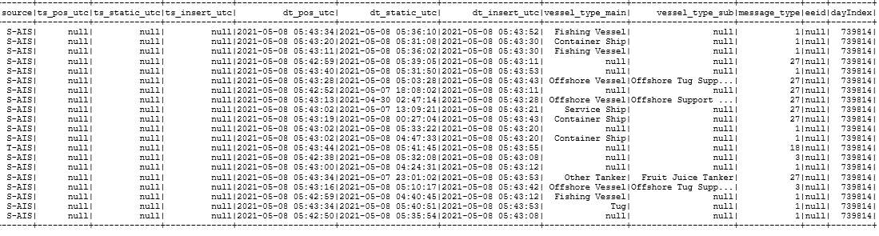
AIS Data example
Source
Time
Notes:
You can also get information like: the source of the transmission, the date and time of the transmission.
To summarize, this provides a rich data set of shipping information to use.

Slide 9
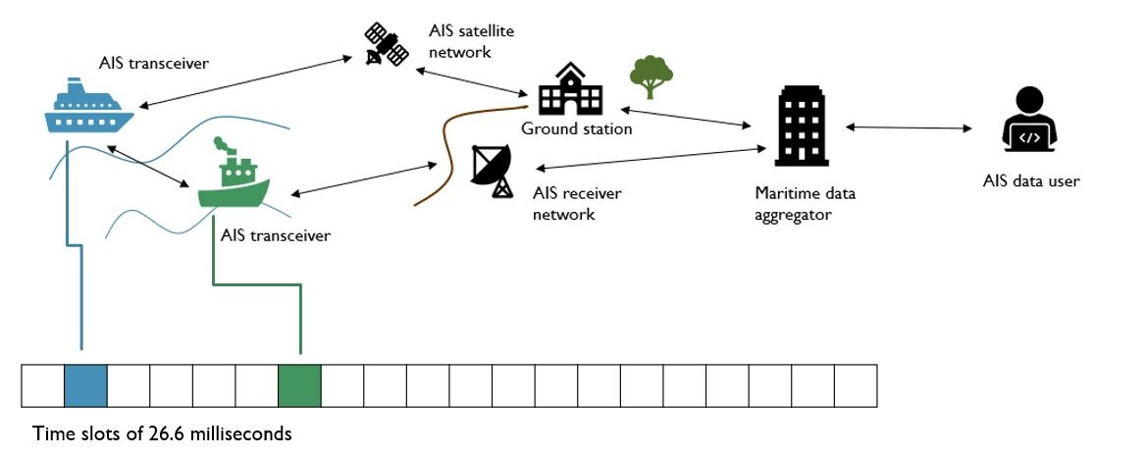
How it works
Static information & voyage related information: are provided by the crew of the vessel and is transmitted every 6 minutes
Dynamic information: is automatically transmitted depending on the vessels' speed and course while underway every 2 to 10 seconds and while a vessel is at anchor every 3 minutes
Notes:
Now, Let’s take a look at how the AIS data is generated.
As I just mentioned, the AIS-equipped vessels can periodically broadcast their identity and position information.
When the ship is close to the shore, it will send AIS message to land-based AIS receiver network
When the ship is far away from the shore, it will exchange message with AIS satellite network, and the satellite network would exchange messages with the ground station.
After this, the AIS messages will be transfer from the ground station and AIS receiver network to a Maritime data aggregator. Here, the AIS data would be edited and aggregated.
And user can get aggregated and cleaned AIS data from the data aggregator

Slide 10

Accessibility of AIS Data
How to get the data?
As the use and demand of AIS data have increased, this enabled the rise of AIS data provider(s) that collect, store, analyze and disseminate AIS data.
Commercial data providers offer access to AIS data that they have collected and enriched, but the costs could be significant
UN Global Platform:
UNSD acquires AIS data from commercial data providers
Makes it available via the UN Global Platform
It is free for experimental and official statistics use and it is accessible around the globe
UN Global Platform provides the storage and computing functionality that required to work with big data
Notes:
So that is theoretically how it works. But how exactly can we access the AIS data?
As the use and demand of AIS data have increased, this enabled the rise of AIS data provider(s) that collect, store, analyze and disseminate AIS data.
Commercial data providers offer access to AIS data that they have collected and enriched, but the costs could be significant
Therefore, the UNSD came up with a solution. We acquires AIS data from commercial data providers, and then make it available via the UN Global Platform
It is free for experimental and official statistics use, and it is accessible around the globe
In addition to offering free data, UN Global Platform provides the storage and computing functionality that required to work with big data

Slide 11
Other AIS data providers
AIS data community:​
AIS Data Exchange Hub (https://www.aishub.net/)​
Government​:
Norwegian Coastal Administration (https://kystverket.no/) ​
US Coast Guard: (https://marinecadastre.gov/ais/)​
Commercial Providers​:
MarineTraffic (https://www.marinetraffic.com)​
ExactEarth (https://www.exactearth.com/) ​
Notes:
You can also obtain AIS data from some other providers listed here.
Like, data provided by the AIS Data Exchange Hub, which is a data community.
Also, the Norwegian Coastal Administration and the US Coast Guard provide AIS data free of charge. However their coverage is localised or may contain coverage gaps.
While, commercial providers like MarineTraffic and ExactEarch do provide good rich datasets however the costs are generally quite high

Slide 12
AIS Data Use Cases
Notes:
Now, let's take a look at in what area can we use the AIS data.
Let’s take a look at how the shipping data is currently being used by different countries and different organizations

Slide 13
General uses of AIS data
AIS data can be used for:
Maritime applications: Navigation at sea, collision avoidance at sea, search and rescue, accident investigation,
Tracking and monitoring: Port monitoring, fleet and cargo tracking
International trade: International trade estimation, economic trend discovery
Environmental statistics: Shipping greenhouse gas emission estimation, ocean currents estimation
…
Notes:
AIS data has traditionally been used for maritime applications, such as: navigation at sea, collision avoidance at sea, search and rescue, accident investigation.
Now it can also be used in areas like port monitoring, fleet and cargo tracking
And it is a very useful data source for analyzing international trade, like international trade estimation, economic trend discovery.
It can also be useful for environmental statistics, like shipping greenhouse gas emission estimation, and ocean currents estimation.

Slide 14


Which field are you interested in?
ⓘ Start presenting to display the poll results on this slide.
Notes:
Now, let me do a small survey, among those fields in which we can utilize AIS data, which field are you interested in?

Slide 15

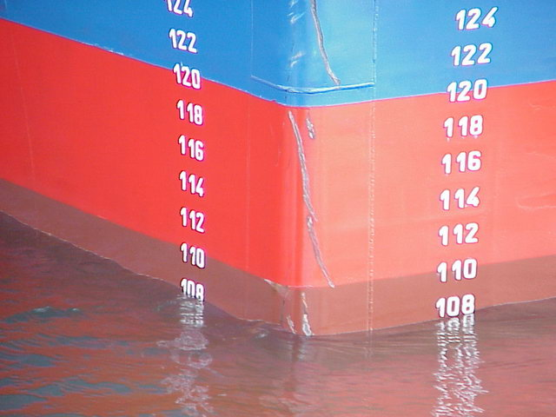
IMF Trade volume estimates
Research question: if the AIS data can be used for trade volume estimation. Enable statistical agencies to complement existing data sources on trade and introduce more timely (real-time) new statistics that measure trade flows.
Research uses Malta as a benchmark
A) Cargo number indicator:
Number of cargo ships visiting a port (filtered)
Comparable with official number of ships
B) Cargo load indicator:
Volume of cargo loaded/unloaded at a port
Highly correlated with the official trade in volume
Conclusion: trade in goods, trade volume, gross trade, and trade by broad groups can be measured with the AIS data.
Notes:
Now, let me show you some use cases.
The first use case is from the International Monetary Fund (IMF). They want to see if the AIS data can be used for trade volume estimation. If yes, this could enable statistical agencies to complement existing data sources on trade and introduce more timely (real-time) new statistics that measure trade flows.
Therefore, in the IMF's working paper, they used Malta as a benchmark to compare the indicators derived from AIS data with the official trade statistics.
One indicator they derived using AIS data is the cargo number indicator. They can use the AIS data to count the number of cargo ships visiting a port. And they found that it is comparable with Official number of ships.
Another indicator is cargo load indicator, we can use the AIS data to calculate the volume of cargo loaded/unloaded at a port. And they found that the cargo load indicator is highly correlated with the official trade in volume.
So, it shows that trade in goods (not in services), trade volume (not value), gross trade (not re-exports), and trade by broad groups (rather than specific goods) can be measured with the AIS data.

Slide 16
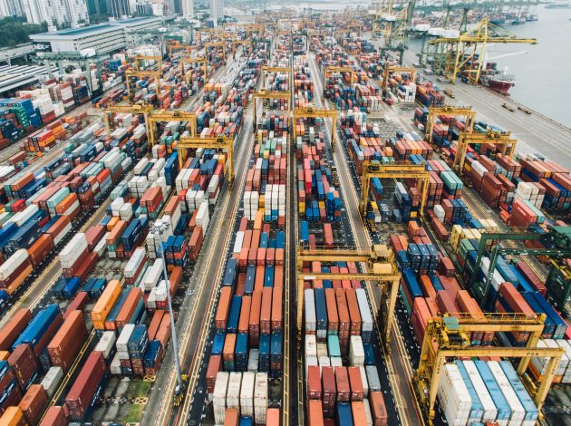

UK ONS Faster economic indicators
Research question: Can we use AIS data to create faster economic indicators, enabling Policy makers to act more quickly?
Research undertaken: Three economic/trade indicators have been developed:
Time-in-port – aggregated time in seconds spent by ships in UK ports
Port traffic – number of unique ships (MMSI) entering port
Number of visits/port calls, e.g. to capture multiple sailing, e.g. ferry route
Future research:
Disaggregate Time-in-port by duration of stay
Anchorage or holding area outside port might contain information, e.g. holding pattern indicating port congestion, increasing oil prices, etc.
Notes:
The second showcase is about “Faster economic indicators”.
In the UK, Policymakers have regularly asked for faster economic indicators, that would enable them to act and adjust policy more quickly in response to economic changes. The Faster indicators of UK economic activity project, led by the Data Science Campus at the ONS, led to the development of such indicators. The goal was to identify close-to-real-time data sources representing useful economic concepts to create a set of indicators for early identification of large economic changes and to provide insight into economic activity. One of these indicators focused on the development of an early picture of international trade in goods. For the UK, maritime shipping is an important modality in the international trade of goods. AIS data provides an obvious source to explore shipping as it is available in almost real-time. The ONS investigated shipping activity for 10 major UK ports, focusing on two new weekly shipping indicators: ‘Time-in-port’ and ‘Total traffic’. These indicators now offer a fast indication of the level of shipping activity, which in turn relate to UK economic development.

Slide 17


Greenhouse Gas Study (Fourth IMO)
Uses AIS data to track and calculate a ship’s emissions:
Movement of ships
Port calls
Speed
Ships characteristics
Merged with other data on engine type, fuel oil consumption and power demand
Can provide an estimate of a ship’s emissions
Can distinguish between domestic and international emissions -> more accurate international shipping emissions
Resulting emissions estimates for each ship are aggregated into annual statistics, broken down by domestic and international voyage, vessel types, and size categories
Notes:
The third use case comes from IMO
The 4th International Maritime Organisation’s study of Greenhouse Gases utilizes a bottom-up methodology to estimate the carbon intensity of shipping. This methodology takes advantage of the AIS data, which tracks the movement of ships, the port calls, the speed and other data relating to the ship’s characteristics, such as ship type. Merging this with other data around engine types and fuel consumption, enables calculations for each ship’s carbon emissions.
The inclusion of AIS data into this study has enabled researchers to better distinguish between domestic shipping and international shipping, by using the AIS data to identify port calls within waters which have been defined as “domestic” or “international”. This has enabled an improvement to the assessment of estimates for international shipping emissions.
The resulting emissions estimates for each ship are aggregated into annual statistics, broken down by domestic and international voyage, vessel types, and size categories.

Slide 18
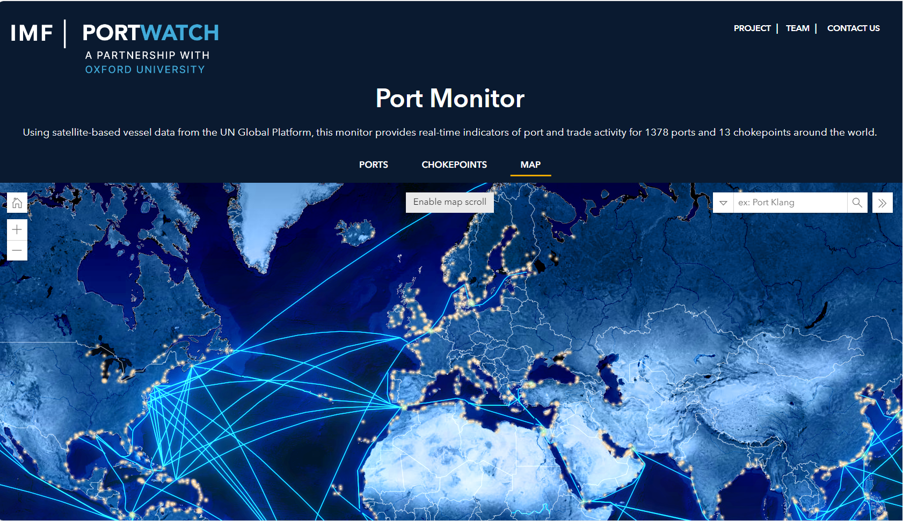
Port monitoring: PORTWATCH
Port Monitor | PortWatch (arcgis.com)
Notes:
Now, the UNSD is running an AIS task team. That is we gathered experts working on AIS data around the world together, and encourage them to collaborate with each other.
Here is a use case of port monitoring. Well IMF work together with Oxford university, they developed a port watch platform to monitor the port around the world using AIS data from the UN Global Platform
This monitor provides real-time indicators of port and trade activity for 1378 ports and 13 chokepoints around the world.

Slide 19
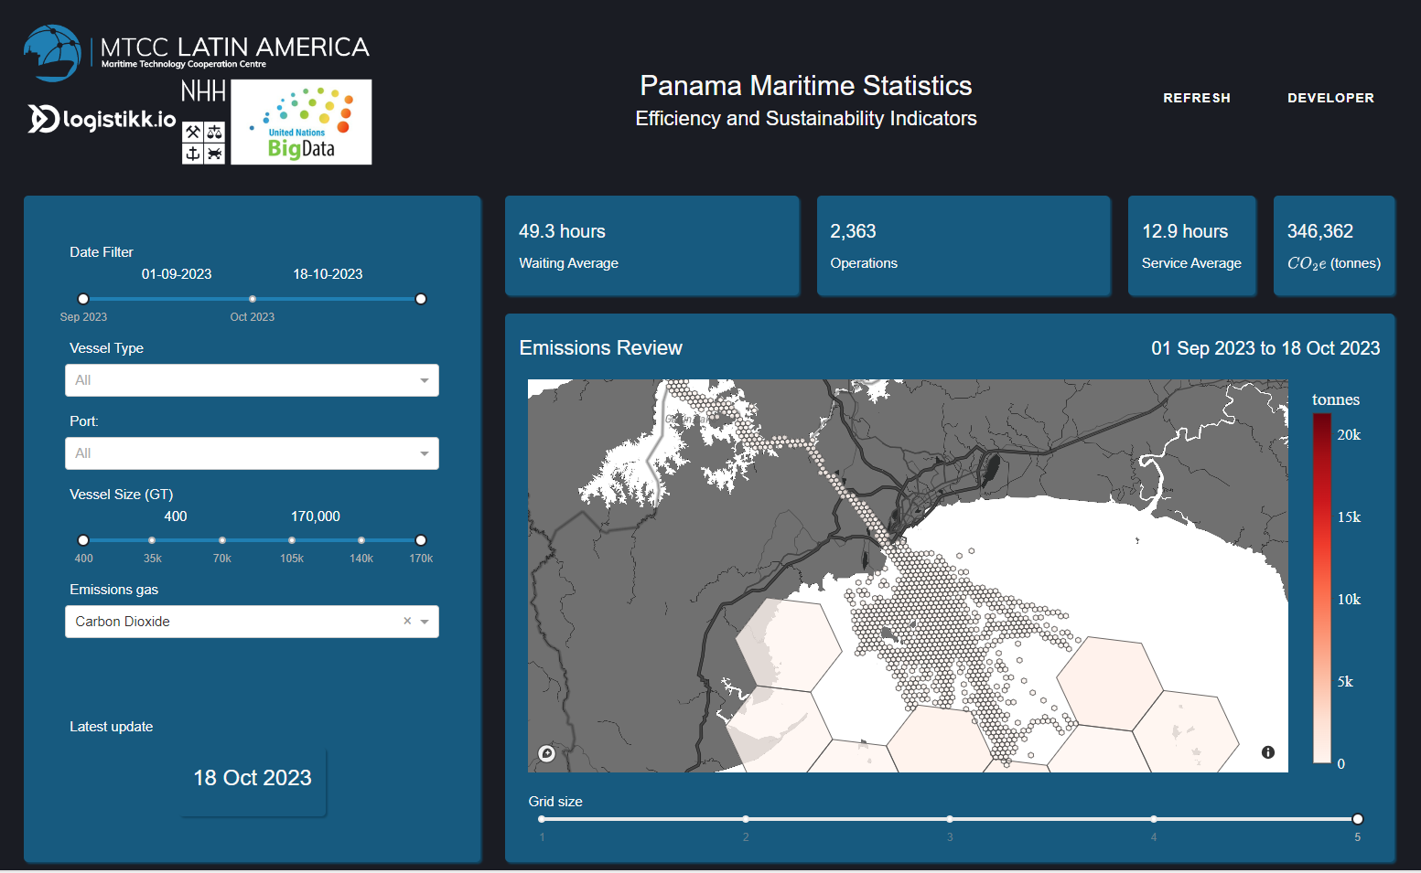
Environmental statistics: Panama Canal case
stats.mtcclatinamerica.com
Notes:
Here is a use case of using AIS data to estimate the cargo emissions.
This dashboard is developed by the NHH university to monitor the emissions in Panama canal.

Slide 20
Acquiring AIS data
Notes:
Therefore, next, let me introduce how to acquire AIS data through UN Global Platform

Slide 21










UN Global Platform for AIS
Platform Services
REST API
GitLab
…
Data Users
Data Computing
Spark Executor
Kubernetes master
Scheduler
API Server
Spark Executor
Spark Driver
Spark Executor
Data Storage
… S3 Buckets …
Data Aggregation
Satellite
Network
+
terrestrial-based
Receiver network
Notes:
Currently, the UNGP platform contains tens of terabytes of global AIS data for the period from 2018 till now.
Here is an overview of the structure of UN Global platform for AIS. There are four parts: data aggregation, data storage, data computing, and platform services.
Let me introduce the structure from the bottom of this figure. The data aggregation part is done by exactEarth. AIS data is collected and aggregated from satellite network and land-based receiver network. The data is made available almost instantly through API.
For the Data storage part, after the data is queried from ExactEarth’s API, then the data is stored in s3 bucket on AWS. The data is saved in s3 as parquet files, partitioned by date. This minimizes the size of data and makes the processing faster and cheaper.
The data computing part is done on Ocean for Apache Spark. Apache Spark provides primitives for in-memory cluster computing. And we use Kubernetes to manage the cluster. Kubernetes is a container construction engine, which allows dynamic starting and stopping of executors of sparks with an auto-scaling ability. As you can see here, the Spark driver distributes the workload across a cluster of Spark executors and runs them in parallel while Kubernetes manages the cluster.
Next, let’s look at the top of this figure. The UN Global Platform provides several services and applications. That allows users to write code and store code on the platform, and allow users to get access to the data and do big data processing, data analysis and data visualization.

Slide 22
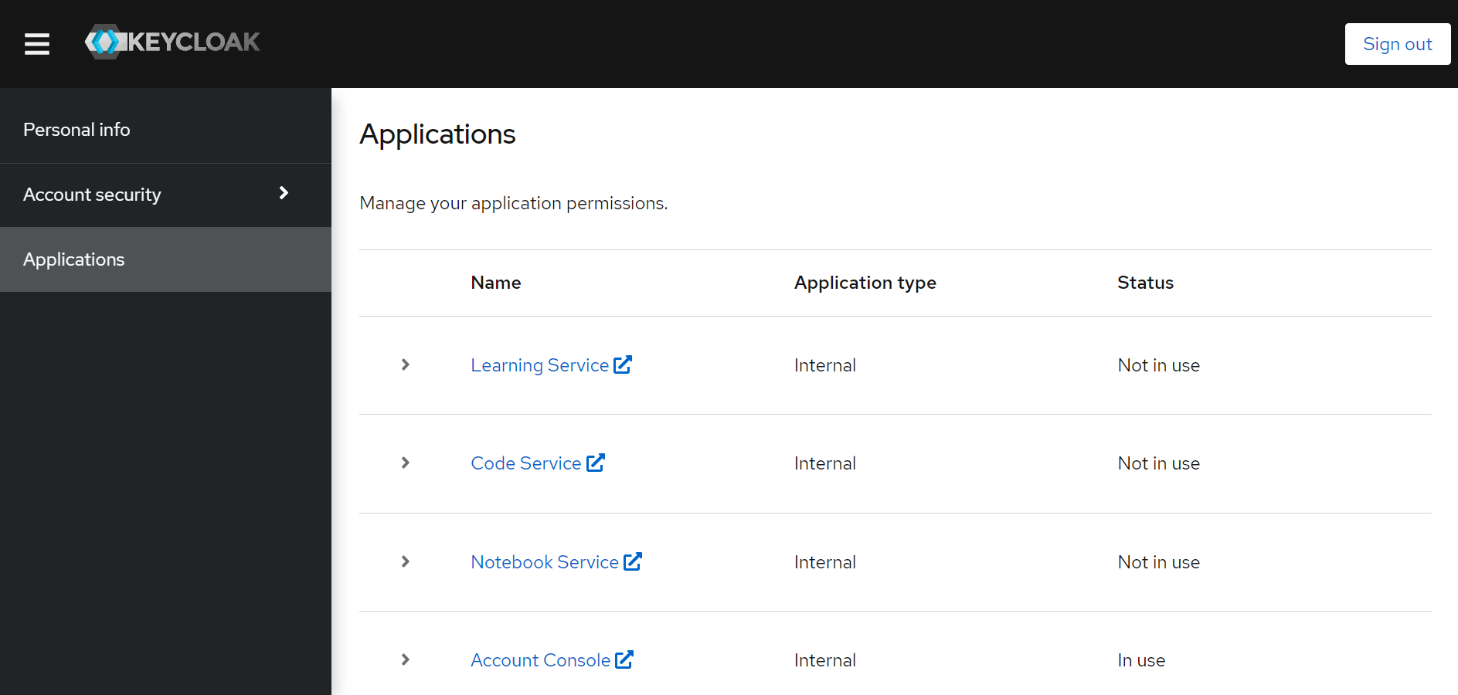
UN Global Platform Overview
Link: https://id.officialstatistics.org/
Notes:
This is the link and the main page of UN Global Platform.
You can see that there are four frequently used applications on the UN Global Platform, including: learning service, code service, notebook service, and account console.

Slide 23
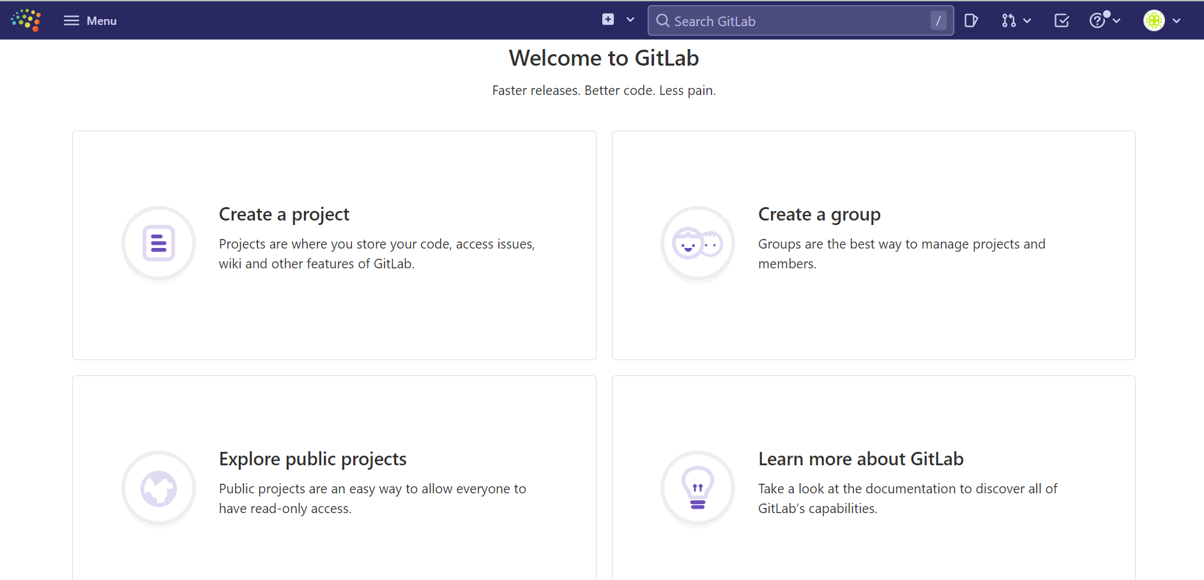
UN Global Platform: Code Service
Link: https://code.officialstatistics.org/
Notes:
This is the view of the UN Global Platform code service. The code service of the UN Global Platform is based on GitLab. You can create a project here, store your code in projects on GitLab and collaborate with your colleagues. You can also join the AIS task team group and obtain AIS related code samples and resources from GitLab.

Slide 24
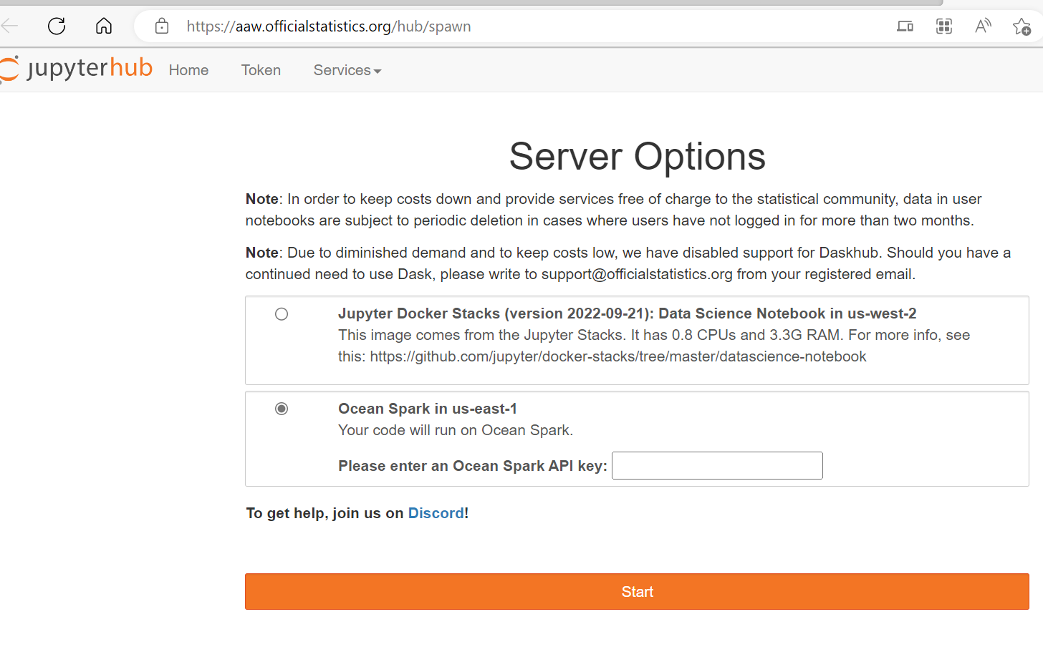
UN Global Platform: Notebook Service
Link: https://aaw.officialstatistics.org/hub/spawn
*Jupyterhub: a browser-based remote computing environment.
Notes:
Next, this is the entry page of the UN Global Platform notebook service. The notebook service of Platform is based on Jupyterhub, which is a browser-based remote computing environment. It is the main point of entry to access AIS data and Spark analytics. Users can write their logic and run their code in here

Slide 25
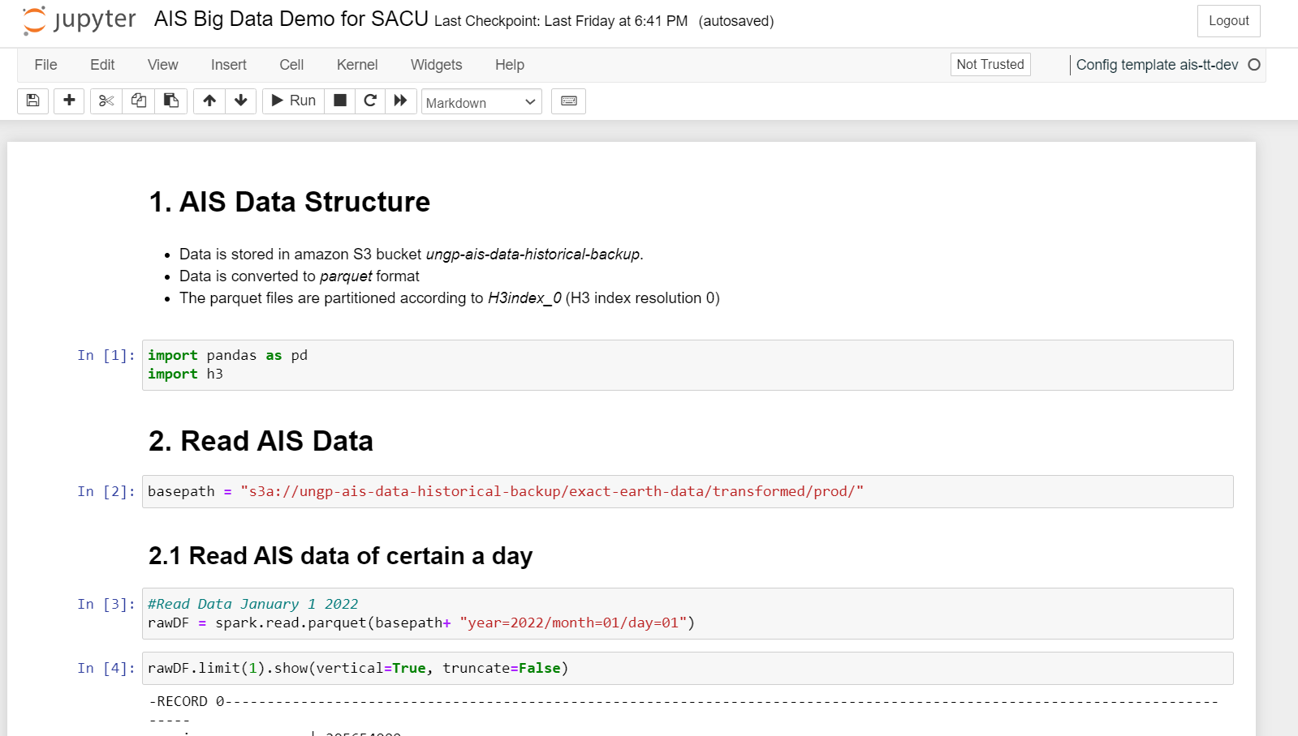
Example of acquiring AIS data
JupyterHub (officialstatistics.org)
Notes:
Now, let me show you a demo of how to acquire AIS data.
Firstly, let’s open this link and go to our platform.
d153178b35e8089500a998ca5e50fbcb8fd870a2c40deb457c531222c288dbbf

Slide 26

AIS Data format
Format: Data is converted to parquet format. Every parquet is partitioned by H3 index resolution 0.
H3 index : Hexagonal hierarchal spatial index
Global grid system developed by Uber Engineering
Each latitude and longitude pair is transformed to a 64-bit H3 index identifying a grid cell
Resolution 0:
Ave. area of ~4.2Mn sq.km
Ave. hexagon edge length ~1,107km
122 unique indices
Resolution 15
Ave. area of 9xe-7 sq. km
Ave. hexagon edge length 0.5m
569 trillion unique indices
Image source: Uber
Notes:
The AIS data is converted to parquet format to store.
Every parquet is partitioned by H3 index resolution 0.
So what is H3 index? H3 index is a hexagonal hierarchal spatial index. It is a global grid system developed by Uber Engineering.
As it shows in the picture, each latitude and longitude pair transformed to a 64-bit H3 index identifying a grid cell.
H3 index have different resolutions like Resolution 0 and Resolution 15.
H3 index resolution 0 is used for AIS partitioning. There are 122 unique indices. The average area is 4.2million sq.km, and the average hexagon edge length is 1107 km.

Slide 27
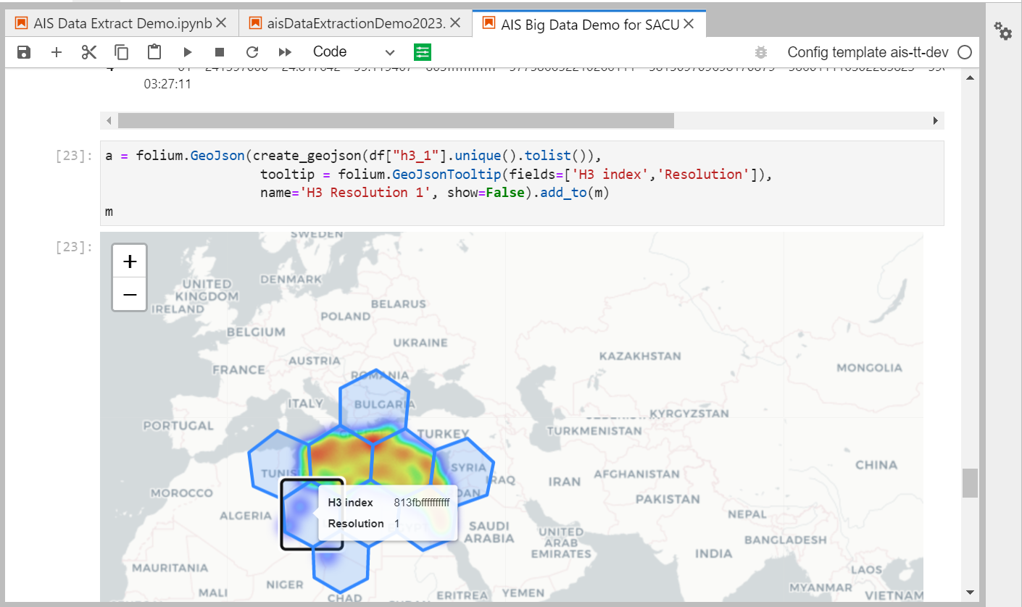
Example of plotting AIS data

Slide 28
AIS Data Strength & Weaknesses
Strengths
Timely statistics can be generated
Aggregated data can be filtered
High frequency data
Weaknesses
Not consistent in some areas and from some vessel sizes (missing data)
Vessels can switch off the device e.g. in piracy areas
Manually input data is based on crew proactivity in timely updating

Slide 29
Useful Resources and Learning Opportunities
Notes:
Before the end of this session, let me share some useful resources and learning opportunities with you.

Slide 30
Learning Opportunities
AIS handbook:
https://unstats.un.org/wiki/display/AIS/AIS+Handbook
AIS E-learning course:
https://learning.officialstatistics.org/course/index.php?categoryid=8
AIS Online Sprint:
1 week training in September
Notes:
If you want to learn more about AIS, you can go to read our AIS handbook. The first link is our page for the AIS handbook. You can get step-by-step guidelines here and download sample scripts. More case studies are also provided.
Or you can take a course on our e-learning platform, to learn more deeply about what is AIS, and how to query the AIS and how to use AIS data.
Also, we plan to have an AIS sprint this year. It would be a 1 week online training in September with administrator and live sessions. In this training, you can get some hands-on practices of using AIS data.

Slide 31
Useful Resources
Official website:
https://unstats.un.org/bigdata/task-teams/ais/index.cshtml
Use cases:
Fourth Greenhouse Gas Study 2020 (imo.org)
Big Data on Vessel Traffic: Nowcasting Trade Flows in Real Time (imf.org)
Faster indicators of UK economic activity: more timely and relevant shipping indicators | Data Science Campus (ons.gov.uk)
AIS Big Data Hackathon:
Winning project: AIS Hackathon — UN-CEBD
Apache Spark: https://spark.apache.org/
Notes:
Here are some useful resources.
If you want to learn more about AIS task team and know what does this task team do, please go to our official website.
Here are the links of the three use cases I just introduced. You can know more details about their research and project here.
We held an AIS Big data hackathon in 2020. If you want to see more interesting use cases of AIS data, you can also view our winning project. Their brilliant idea may inspire you.

Slide 32
How to request access
USER emails
USER
support@officialstatistics.org to request for AIS Data Platform access through UNGP. User must provide the following information:
Full name:
Email address:
Nationality:
Details on your use of AIS:
receive a welcome email and activation link.
User activate the account
SUPPORT TEAM
SUPPORT TEAM
SUPPORT TEAM
receives and reviews request
creates accounts on UNGP and send invitation to the user to join AIS Task Team
requests USER to fill-out the form at: https://forms.office.com/r/0k1QBZunKe for tracking
Start
Finish
Notes:
Finally, let me introduce how to request access to the UNGP AIS. After you get the access, you can try to run the code, analyze AIS data, and work on your own project.
To request access to the AIS data on the UN Global Platform, you need to send an email to support@officialstatistics.org and provide: your full name, email address, nationality, and details on your use of AIS.
The support team would review the request. If your request is qualified, the support team would create an account for you on the UN Global Platform and send an invitation to join. After receiving the welcome email, you can click the activation link and activate the account. Apart from this, the support team would also request the user to fill-out a form for tracking.

Slide 33
Q&A
Do you have additional questions?
Notes:
OK, thank you everyone for listening.
If you have any question, maybe you can raise your hand, or you can let me know in the chat

